Slide 1

Developing Virtual Reality Software from Scratch
Presenter: Kyle Lotterer
Faculty Advisor: Dr. Arkady Retik
Sponsor: Colby Easton

Slide 2
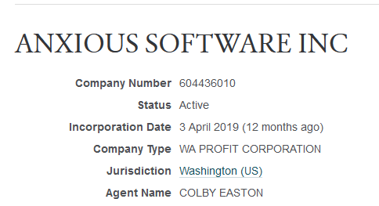
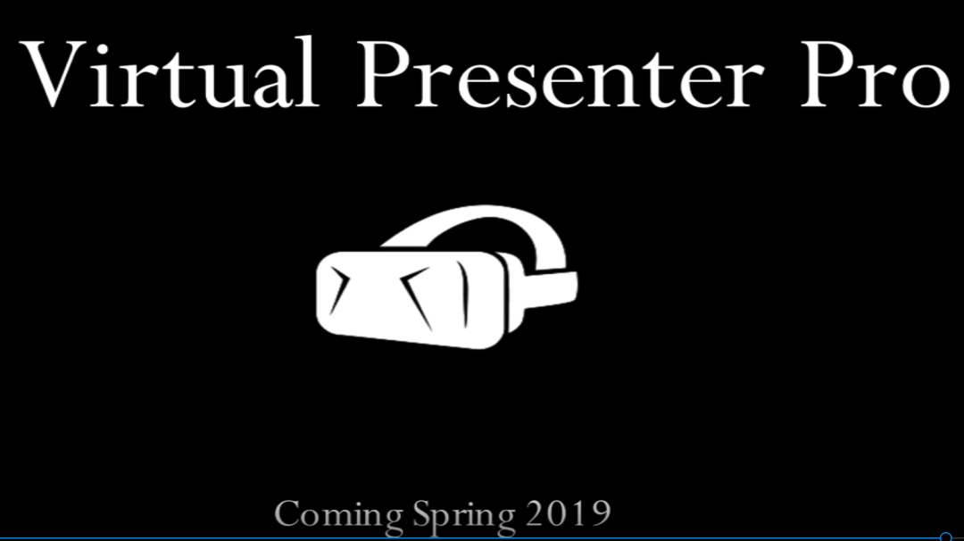
Introduction
We are five individuals who formed a company
Based off a school project
Found a universal issue to solve
Public speaking
No other similar products on the market
Offer high quality for a low price

Slide 3
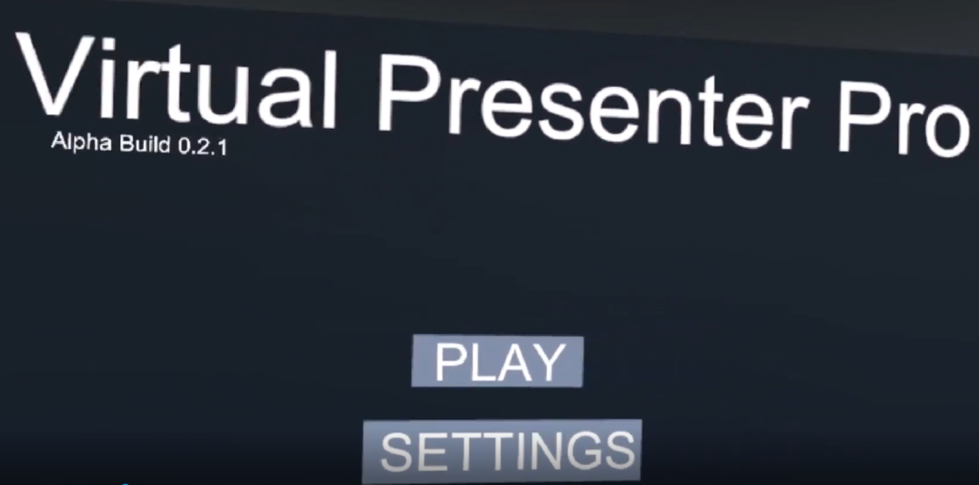
Starting from Scratch
How do you begin a massive project?
Brainstorm
Write user stories
Identify requirements/minimum viable product
Create prototype
Screenshot from early menu

Slide 4
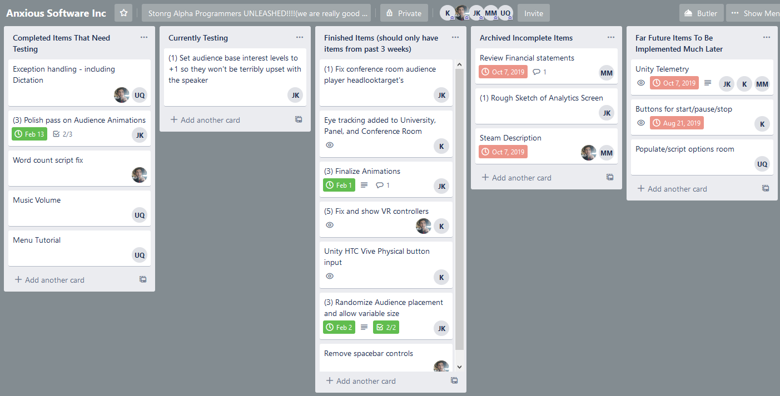
Sprint Meetings
Weekly sprint meetings for progress reports
Talk about what you did/what you will do

Slide 5


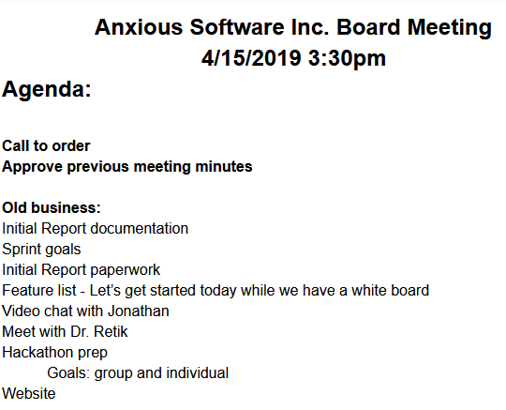

Brainstorming
Get into a room and talk!
Talk about what you want in the application
Helps to have a single dedicated leader
Take notes on the ideas and process them later
Early meeting agenda

Slide 6
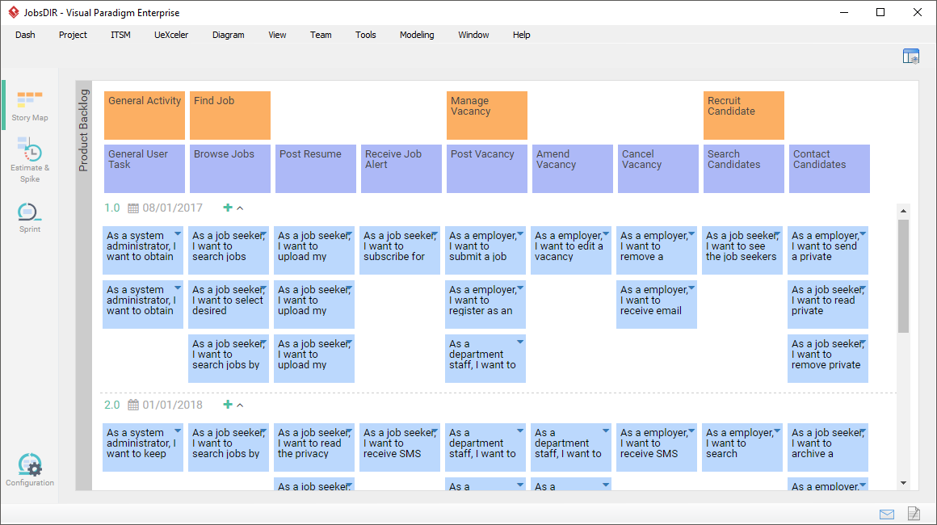

User Stories
Short paragraphs of what users want
Not a priority for us

Slide 7

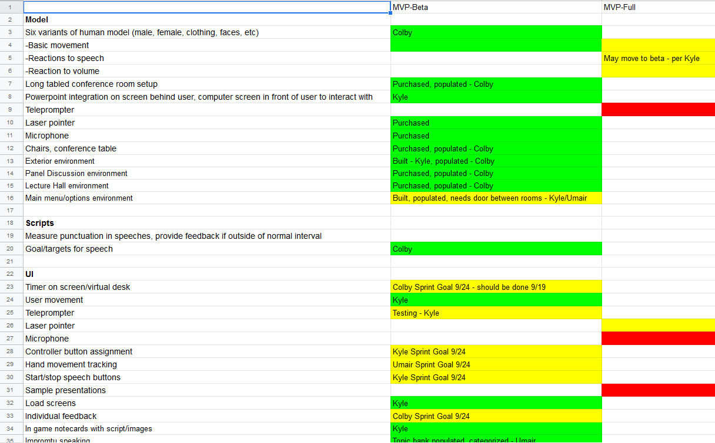
Identifying Requirements

Slide 8
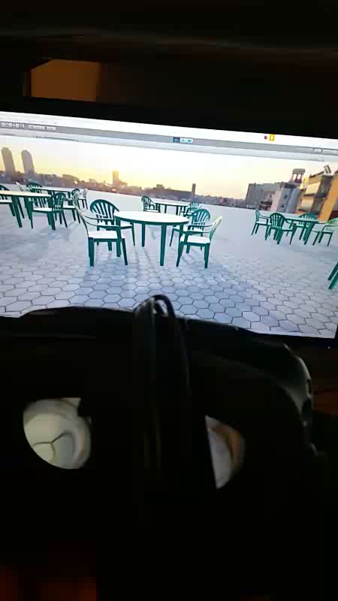

First Prototype

Slide 9


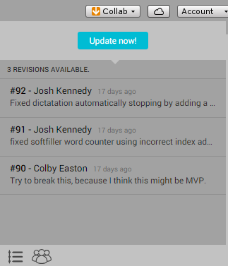
Version Control
Chose Unity’s cloud-based tool
Called Unity Collaborate
Built into the unity editor
Similar to GitHub
Has a base version
which you fetch from/push
Maintains version history
Does not include branching

Slide 10

Problems with Unity Collaborate
Down for long periods of time
Fetches from base file are not identical
Easy to get merge conflicts
Difficult to fix them at times
Modifies file for you without notification

Slide 11

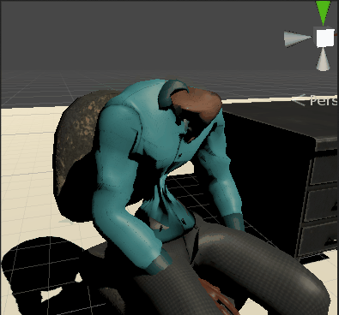
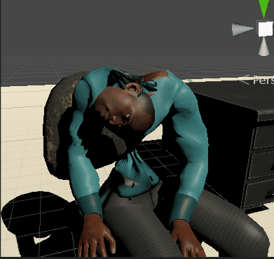
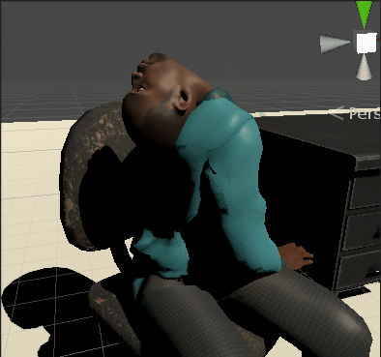
Developing for Virtual Reality
Immerse the user
Not as effective if it seems fake
Use the 3d space
Our first model Liam had some minor skeleton problems

Slide 12
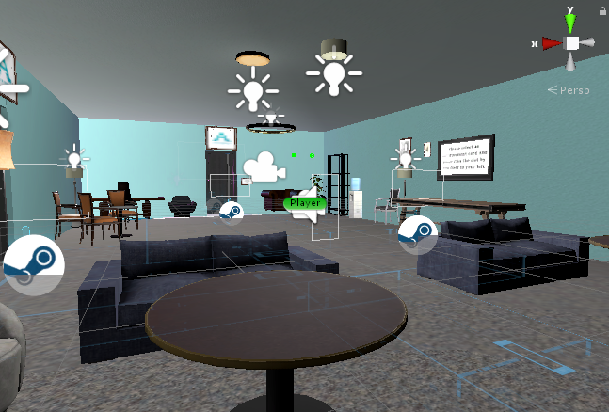
Creative Main Menu

Slide 13
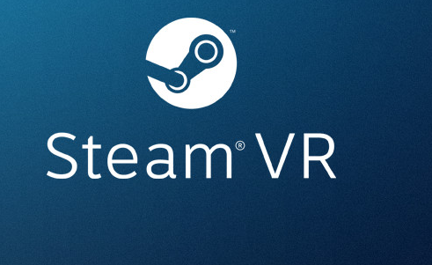
Integrating Virtual Reality
Initially tried an unsupported API OpenVR
Had several problems
Not good for portability
Used SteamVR API in Unity
Great library of scripts such as Teleportation

Slide 14
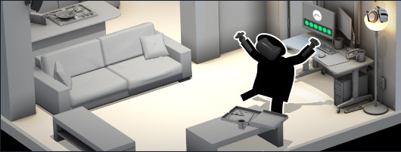
Integrating Virtual Reality
SteamVR Integration
Import from Unity Asset Store
Set up controller bindings for each device
Organize resources in scenes

Slide 15
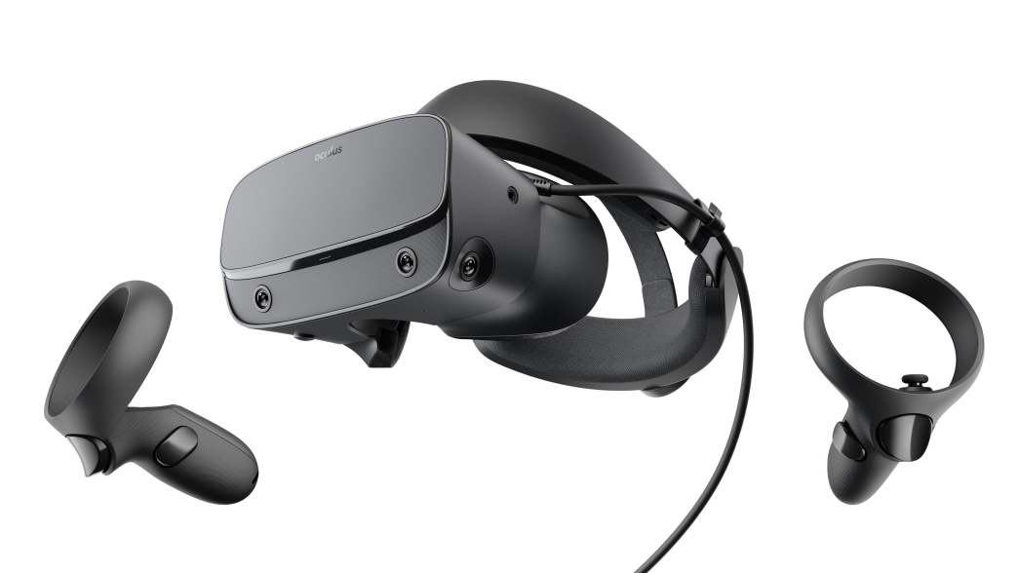
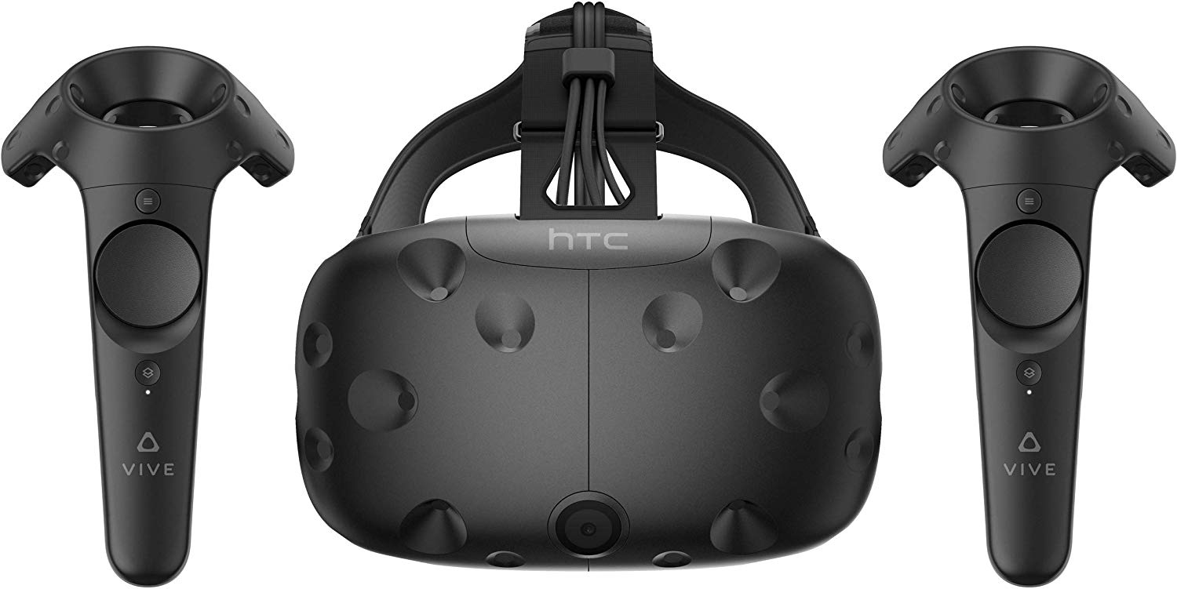
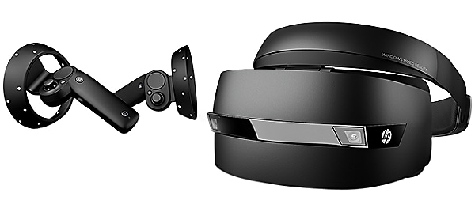
Multiplatform Support
Oculus Rift
HTC Vive
Windows Mixed Reality

Slide 16

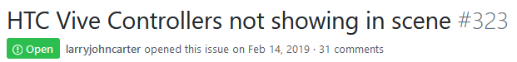

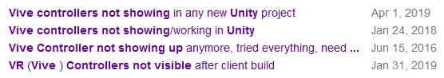
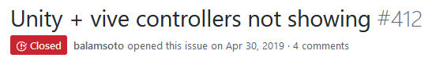
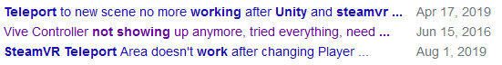
Virtual Reality Problems

Slide 17
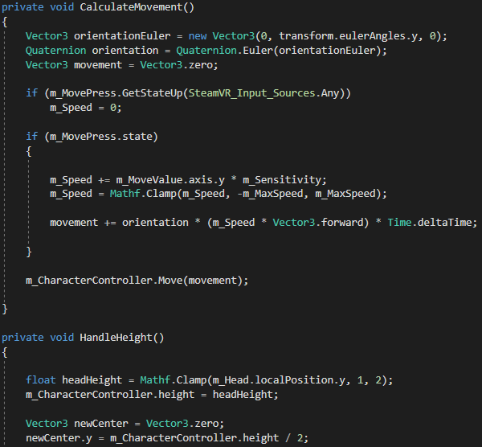
Movement: Locomotion
Use controller’s thumb pad to move
Sudden translation induces nausea

Slide 18
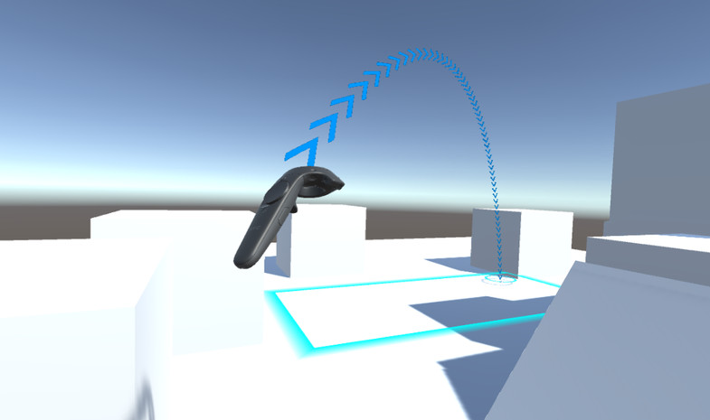
Movement: Teleport
Screen fades in/out while teleporting
Does not induce nausea

Slide 19
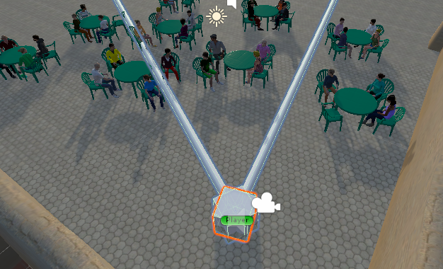
Head Tracking Algorithm
Goal: All audience members receive attention
How do we track this?
User’s head rotation
How do we give coherent user feedback?
Split the environment into three segments
LEFT MIDDLE RIGHT

Slide 20
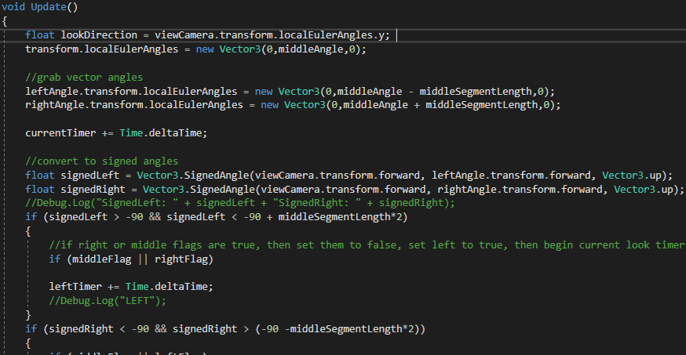
Head Tracking Algorithm

Slide 21

Further Steps
Release to Steam Marketplace
Add additional features
Upload PowerPoints/notecards
More environments

Slide 22
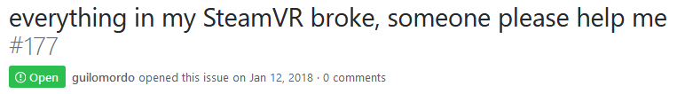
What I Learned
Team collaboration and agile development
Creating tasks and leading design
Became comfortable working with VR
Looking for a job in VR after college
Self-reliance > outsourcing help
Stackoverflow won’t always be there to save you

Slide 23
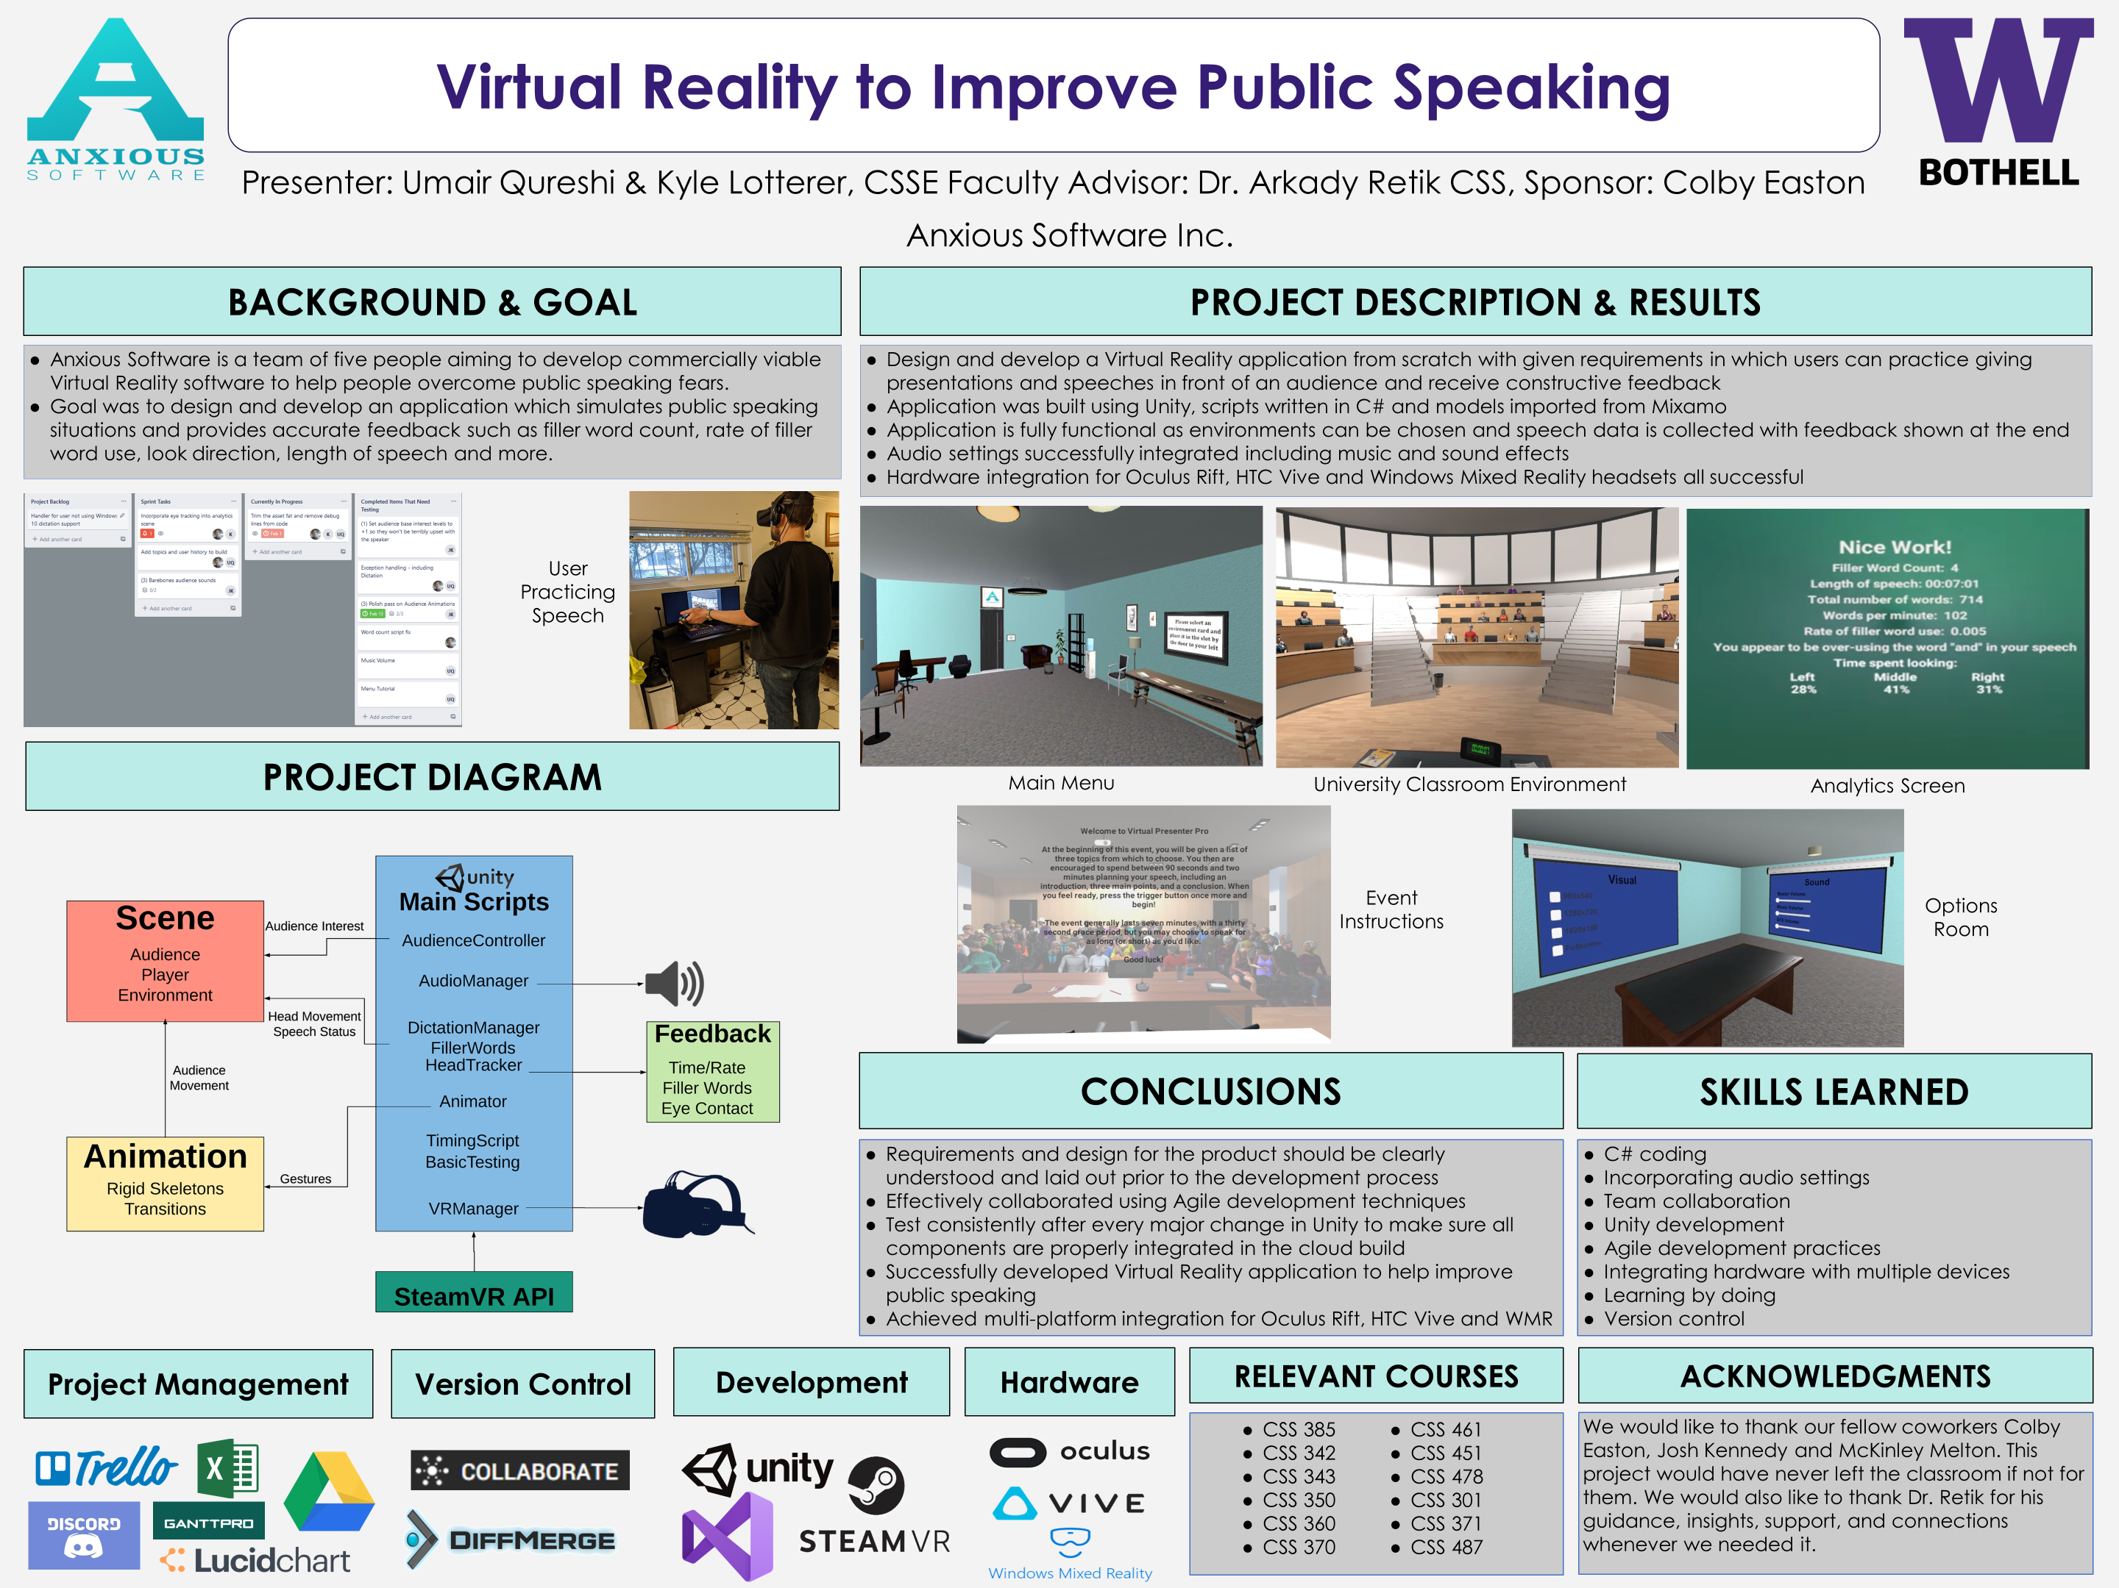

Slide 24
QUESTIONS

